Slide 1
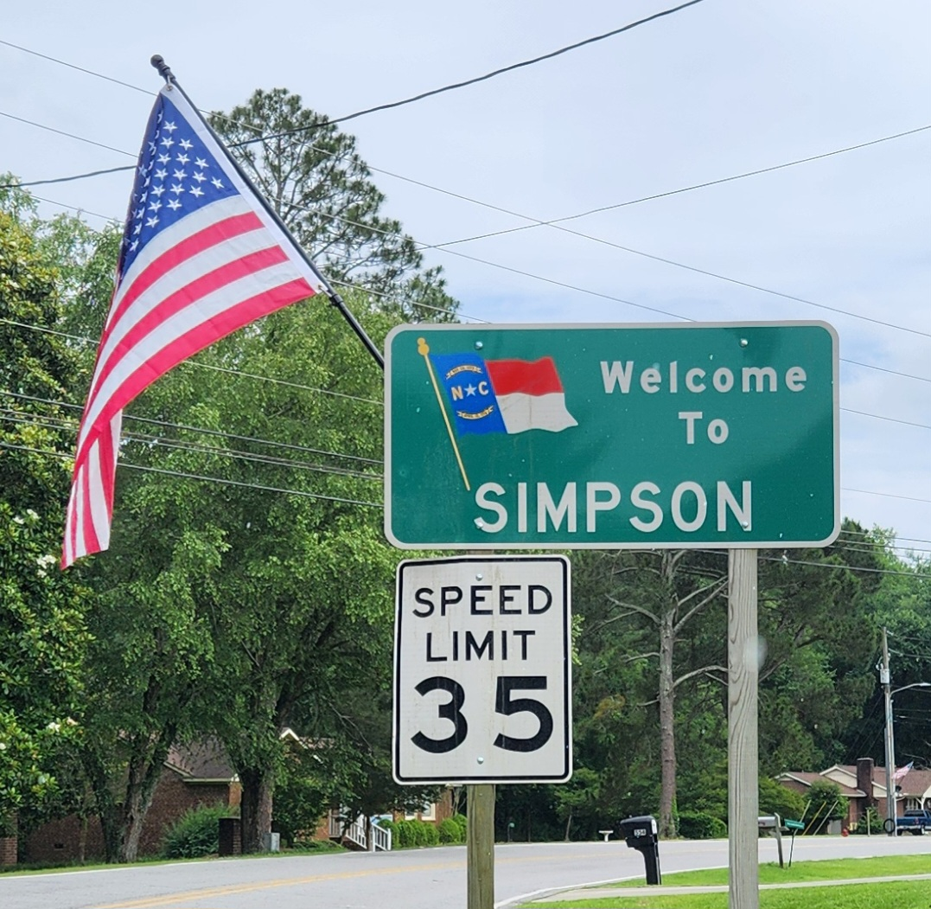

Village of Simpson
Community Meeting
www.uswateralliance.org
Notes:
Welcome - mayor

Slide 2
Introductions
Village of Simpson
Pitt County
Greenville Utilities Commission (GUC)
The Wooten Company
MDB, Inc.
Southeast Rural Community Assistance Project, Inc. (SERCAP)
Mid-East Commission
NC Department of Environmental Quality, Division of Water Infrastructure (NC DWI)
U.S. Department of Agriculture – Rural Development (USDA-RD)
Notes:
MDB

Slide 3
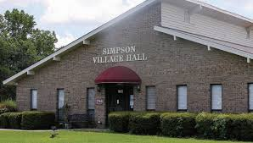
Goals of the Community Meeting
Discuss history of this project and why the Village desires a wastewater solution.
Introduce Closing America’s Wastewater Access Gap initiative.
Review the recommended solution from the updated Preliminary Engineering Report (PER).
Review potential funding options.
Answer questions.
Notes:
MDB

Slide 4
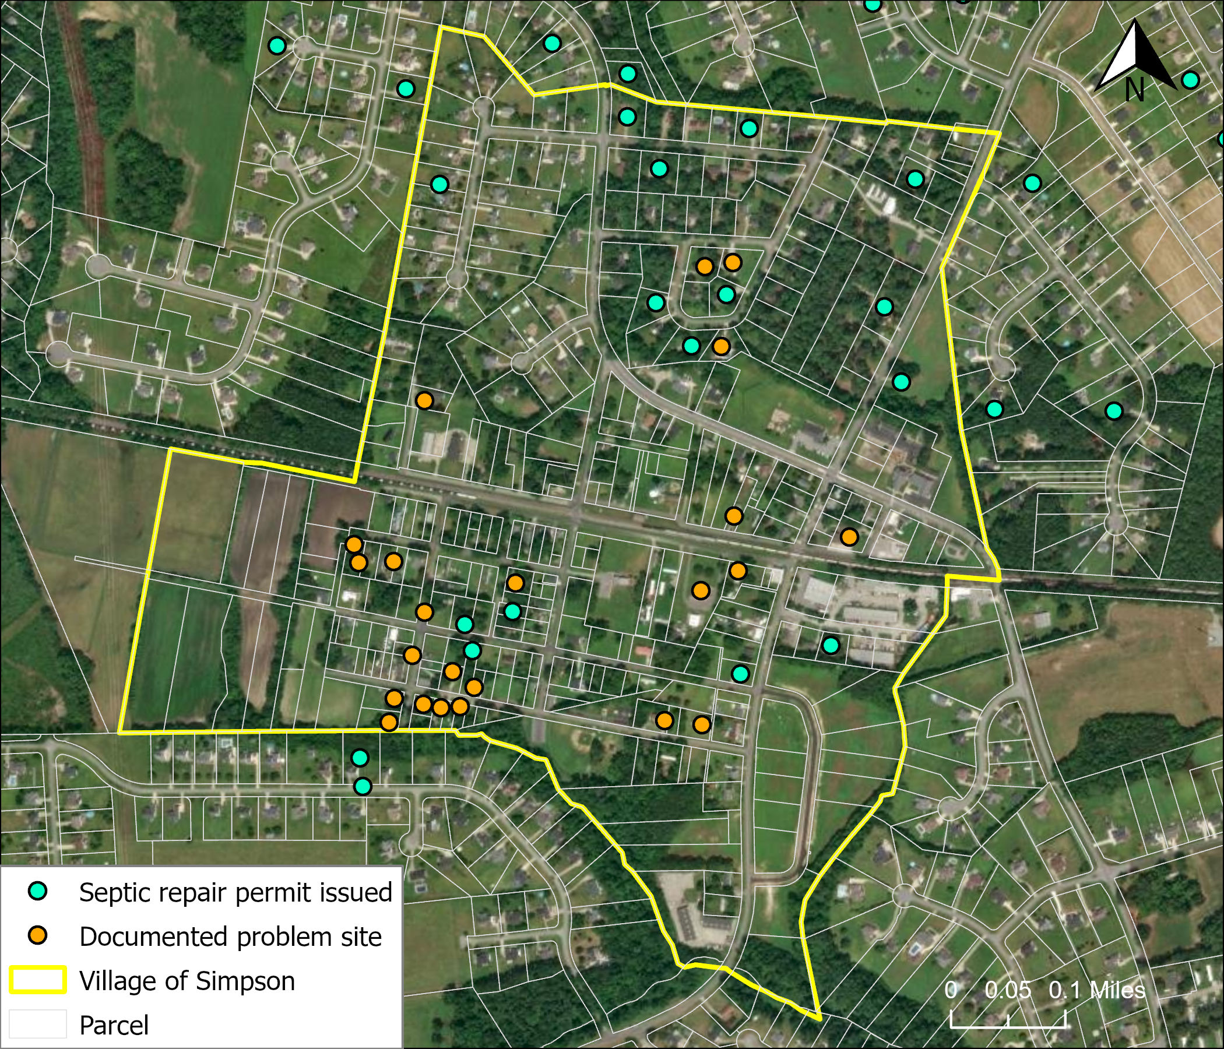
Project Background
In 2008, 71 properties were surveyed, which showed:
Inadequately sized lots for repairs (24)
Inadequately constructed system (17)
Flooded drain fields (12)
Straight pipe to ditch (5)
System appears functional (28)
Since 2008,
17 repair permits issued within Village, 52 in its jurisdiction
23 documented problem sites, most have issues in wet weather
Notes:
Will

Slide 5
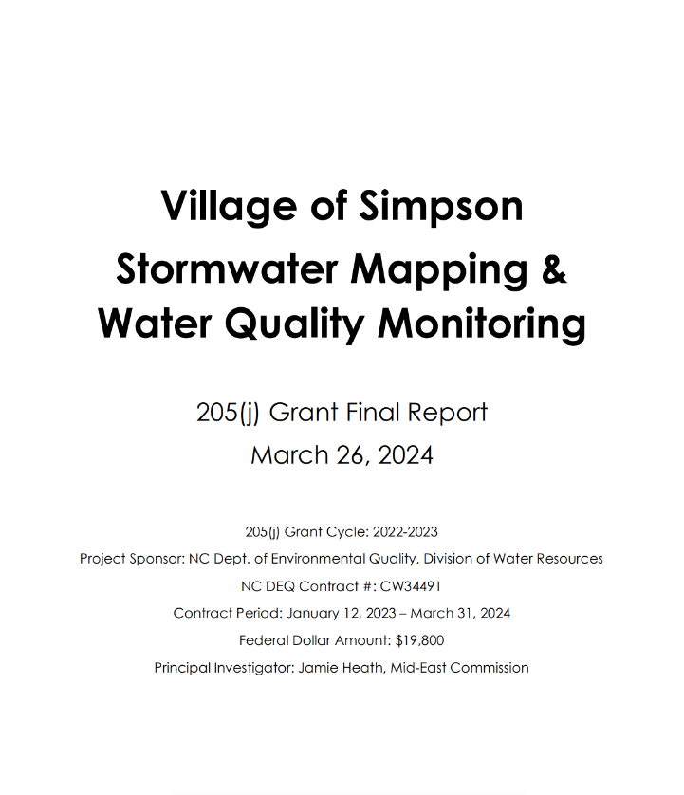
Project Background
In March 2024, a water quality study was completed which revealed:
Elevated E.coli levels in local surface waters, intensified by rain events
DNA sampling showed E.coli was of human origin, suggesting failing septic tanks as source.
Notes:
Jamie/Sound Rivers

Slide 6
Project Background
Risks from E.coli water pollution:
Indicates possible presence of disease-causing bacteria and viruses.
Individuals who swim or come in contact with these waters are at increased risk of getting sick.
Source: EPA
Notes:
Jamie/Sound Rivers

Slide 7
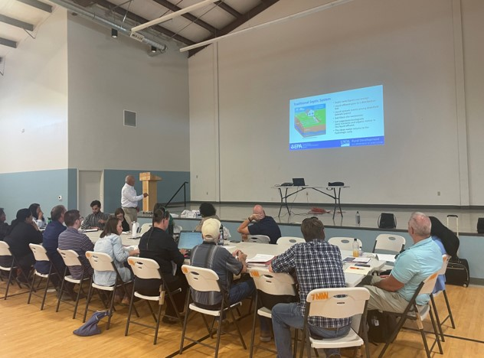
Closing America’s Wastewater Access Gap Initiative
No-cost technical assistance to communities with failing septic systems.
Supporting communities across the U.S. and its territories.
EPA funds Preliminary Engineering Reports (PER), community meetings, and contractors to support development of wastewater solutions.
Notes:
MDB

Slide 8
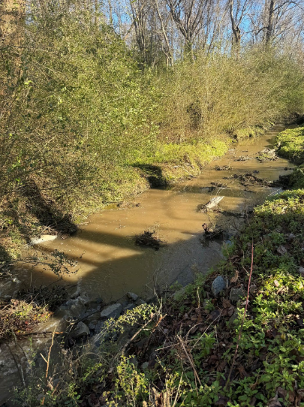
Need for wastewater solution
Health, sanitation, and security
Simpson soils not ideal for onsite septic systems
Small lot sizes do not allow for repairs
Septic system failures cause local surface water pollution
Protect future generations
Growth
Economic development hindered by lack of centralized wastewater capacity
Bate’s Branch, Simpson, NC
Source: 205(j) Grant Report
Notes:
MDB

Slide 9
Wastewater Alternatives Considered
No action
Homeowner’s septic systems will continue to deteriorate and fail.
Onsite repairs mostly unfeasible or very costly.
Low-Pressure Sewer System (high maintenance)
Each residence has its own wastewater collection tank and pump (Septic Tank Effluent Pump (STEP) or grinder pump system), which pumps to a central collection point
Requires more maintenance.
Gravity Sewer Collection System (recommended)
Replace septic systems
Wastewater flows by gravity to central location and pumped to treatment location.
Notes:
Will

Slide 10
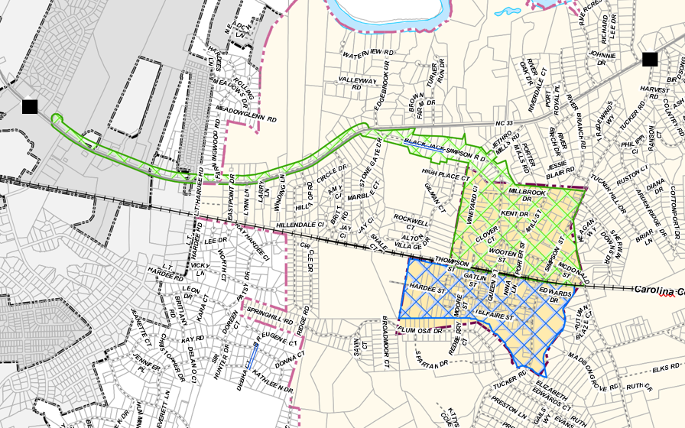
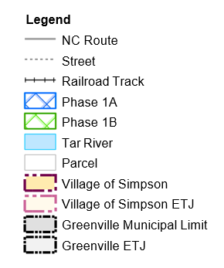
Recommended Solution
Gravity Sewer Collection System: connect to Greenville Utilities Commission (GUC) wastewater system using a conventional gravity system.
Phase 1A: Simpson corporate limits, south of railroad tracks
Phase 1B: Simpson corporate limits, north of railroad tracks
Notes:
Will

Slide 11
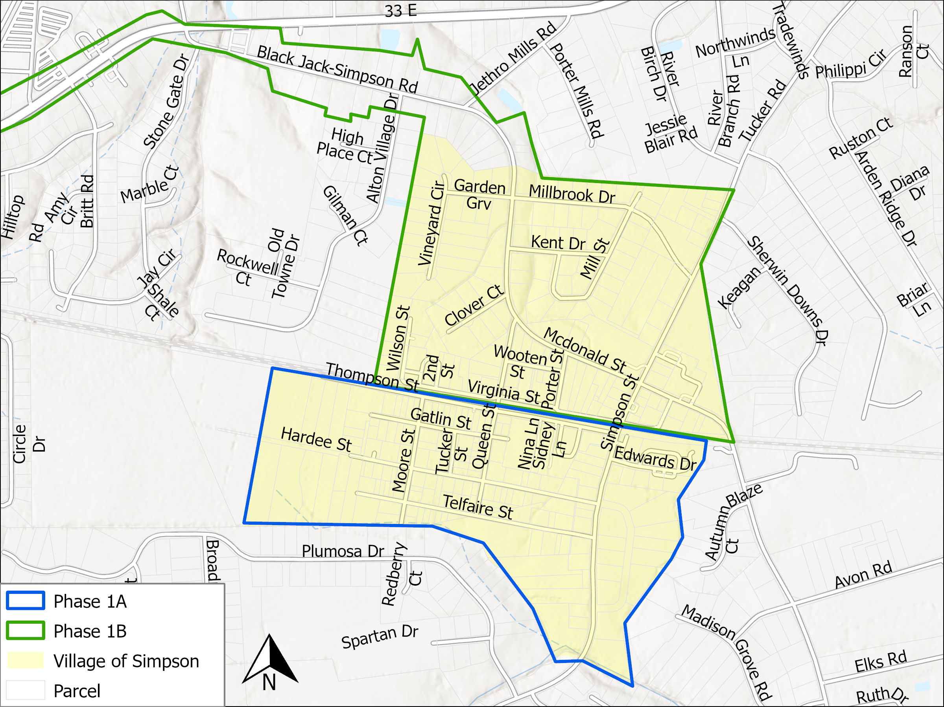
Recommended Solution
Phases 1A and 1B
Notes:
Will

Slide 12
Pros & Cons of Centralized Wastewater Collection
Pros
Permanently fixes plumbing and septic problems
Provides safe and reliable wastewater collection and treatment
Protects rivers, streams, and public health
Supports residential and light commercial development
Cons
Requires construction in area
Potential one time tap fee
Monthly sewer bill
Notes:
Will

Slide 13
Next steps
Updated Septic Survey (to maximize grant funding)
Village Council Support
Funding Applications
Bond Referendum
Design & Permitting
Wastewater System Construction & Connections
Notes:
Will

Slide 14
Funding Considerations
Debt service payments
Until funding applications are approved, exact grant and loan amounts are unknown.
Total expected project cost for gravity sewer system and connection to GUC is $18.4 million.
Upfront connection costs (tap fees) and monthly sewer fees
Not all funding agencies cover tap fees.
Monthly sewer fees will vary based on the amount of debt service.
Notes:
Will

Slide 15
Potential costs
Monthly Sewer Bill
Minimum Charge | $ 23.50
Debt service* | $41.40 +
Cost per 1,000 gallons | $7.55
For 2,000 gal/mo. Customer* | $80.00 +
Customer costs include:
Tap fee (one time)
Monthly sewer bill (ongoing) with a minimum charge and cost for water usage.
Funding assistance:
The Village will seek funding assistance from State and Federal sources for system construction.
*dependent on grants vs. loan amount (20-60% loan expected)
Septic System Repair and Maintenance
Pipe and connection repairs: $1,000-$2,000
Drain field repairs: ~$2,000-$10,000
Septic pump replacement: ~$500-$1,200
Septic tank pump out: ~$350-$400
Notes:
Will

Slide 16
Funding Options
Source | Grants available | Loan Terms
Clean Water State Revolving Fund (CWSRF) | Up to $500,000 | 20-year loan, 0-2% interest
U.S. Department of Agriculture Rural Development (USDA-RD) | May be available | Up to 40-year loan, ~3.5% interest rate
Housing & Urban Development (HUD) Community Development Block Grant Funding | Maximum $3 million *income survey required
Notes:
Will
Change to table, minimize verbiage, simplify
Grants and loans available through these mechanisms but need to get further along before we know what those amounts will be.

Slide 17
What does your support mean?
Yes
Improved water quality
Reduced environmental and public health risks
Preserved/enhanced property values
Planned sewer bill expenses
No
Limited future growth capacity
Potential negative health risks
On-going plumbing issues for some residents
On-going septic system repair and maintenance costs
Notes:
Will

Slide 18
Expected Project Schedule
TASK Septic Survey Funding Acquisition Bond Referendum Engineering Procurement Field Survey Engineering Design Permitting | COMPLETION MILESTONE October 2025 July 2026 September 2026 January 2027 April 2027 December 2027 February 2028
Notes:
Will

Slide 19
Thank you for your attendance.

Slide 20
Questions?

Slide 21
General Q&A
Who will be served by the new collection system?
Who will maintain Simpson’s sewer system?
Where will my wastewater be treated?
If my septic tank works, will I be required to physically connect to the sewer system?
Can I continue using my existing septic tank once I connect to the sewer system?

Slide 22
Construction Q&A
Will construction cause traffic inconveniences?
Will the streets be repaired after the sewer system is constructed?
Will all sewer be installed in the streets?
Will my yard be repaired after the sewer system is constructed?
When can I connect to the sewer system?

Slide 23
Policymaking Q&A
When will I have to pay a tap fee?
Will I be charged a flat rate or will my sewer bill vary with water usage?
If I am not connected to the sewer system, will I be charged a sewer bill?
Can sewer be extended outside Phase 1A and 1B service areas?

